Slide 1

AIP OR Preceptorship
Presented by Megan Hellrung
May 28, 2015

Slide 2

Course objectives
Define the role of preceptors within the perioperative setting
Describe key elements of the teaching/learning relationship of precepting
- identify 3 primary roles of the preceptor
- demonstrate use of principles of adult learning theory
- facilitate development and competence through skill acquisition hierarchy
- describe methods for constructive evaluation
- use of effective communication skills
Discuss the unique situations and distinctive resources available to facilitate preceptorship in the perioperative setting

Slide 3
Background: preceptorship in aip or
Preceptorship is defined in current professional practice literature as a specialized one-on-one relationship where on-site clinical experience is facilitated by an experienced staff member assuming the role of clinical instructor in order to bridge the theory-practice gap (Altmann, 2006)
- Current practice of preceptorship within the healthcare industry stems from the originator of modern nursing education, Florence Nightingale, who structured her educational model with students working with nurses ‘who were trained to train’ (Omansky, 2010)
The University of Colorado Hospital Preceptor Policy defines a preceptor as “an employee or designee who functions as a teacher and mentor in guiding, directing, and overseeing the orientation and/or training of a designated employee or student”
- HUB→ Policy, Procedures and Guidelines→ Preceptor
or
- HUB→ Departments & Services→ P→ Preceptor Program→ Forms and Documents → Preceptor Policy

Slide 4
Background: preceptorship in aip or
What is the current practice of preceptorship on nationwide scale?
- Preceptorship programs are a common teaching method in US baccalaureate schools of nursing as well as in US health care institutions and health care systems
What is current practice of preceptorship in the AIP OR?
- Preceptors are utilized daily, however, the preceptor role, responsibilities, education and expectations are undefined and under supported in conjunction with high turnover rate and quantity of novice staff
How do we know the current state of preceptorship practice in the AIP OR?
- Staff discussion/discourse, physician feedback, staff turnover/exit interviews, survey results

Slide 5
Background: Preceptorship in AIP OR
What does our unit specific leading organization, AORN, recommend concerning preceptorship?
- AORN strongly encourages the use of preceptors within the perioperative settings by highlighting selection of the right preceptor.
How will we change AIP OR’s practice of preceptorship to meet national standards, AORN recommendations and most importantly support our staff with preceptorship?
- The development of an OR specific clinical preceptor education course placing emphasis on clarifying role ambiguity, identifying preceptor teaching ability, increasing resource accessibility and improving preceptor evaluation (otherwise known as THIS COURSE!)

Slide 6

Online lesson review
Thoughts?
Based on the modules, what does the overall role of a preceptor look like?

Slide 7

Or preceptor role description
OR Preceptorship:
“The Clinical Preceptor in the AIP Operating Room is either a competent Level II Clinical Nurse (RN) in the UEXCEL Professional Practice Plan or Certified Surgical Technologist. The Clinical Preceptor utilizes both hospital and unit based policies and procedures as well as the Association of Operating Room Nurses (AORN) professional practice guidelines to direct new staff in either the circulating nurse role or surgical scrub role”…
* Please refer to the Preceptor Role tab in your manual at this time

Slide 8
Divisions of the preceptor
Characteristics of the preceptor facilitate clinical success
Teaching-learning relationship is the basis of preceptorship
Communication is principle in precepting
Professional and personal progression supports the preceptor
https://thesource.uchealth.org/PaS/Progams/precept-uch/Pages/defualt.aspx
*Please refer to the Preceptor Tools tab in your manual at this time

Slide 9
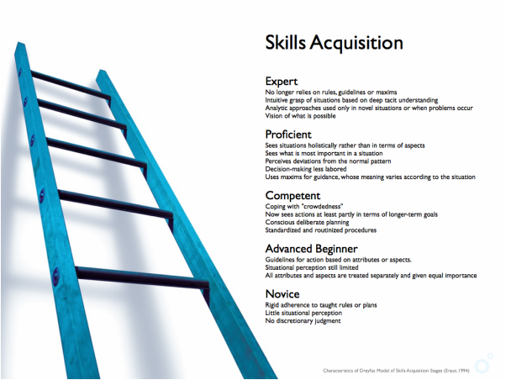
Staff development
“Benner (1984) suggests that by using the five stages of skill acquisition (novice, advanced beginner, competent, proficient, and expert), it is possible to determine performance characteristics and learning needs at each student level, as well as the preceptor characteristics required to teach that preceptee” (Altmann 2006, p. 2)
* Please refer to the Preceptor Tools tab in your manual at this time

Slide 10
Novice to expert theory
The novice to expert theory also know as Benner’s Model is a theory used as a model of “skill acquisition and development when describing nurses perceptions of clinical practices at various levels of proficiency” (Finger & Pape 2002, p. 634)
The model identifies five levels of expertise and shows the gradual increase in proficiency improves the ability to select the most appropriate preceptor
The five levels of proficiency include:
1.) Novice- an inexperienced individual who is expected to follow rules and develop skills yet has limited or no understanding of the abstract meaning of skills/behaviors
2.) Advanced beginner- an individual with minimal experience who can perform skills under strict guidelines but has difficulty troubleshooting
* Please refer to the Preceptor Tools tab in your manual at this time

Slide 11
Novice to expert theory
3.) Competent- an organized individual with first-hand experience that is aware of actions, uses emotional responses, can discuss clinical situations intelligently and sees the big picture
4.) Proficient- an experienced individual who perceives a situation in relation to past experiences and previous knowledge, actively modifies actions based on understanding of clinical situation and has emotional awareness
5.) Expert- an individual with several years of experience who utilizes knowledge to lead situations intuitively, able to multitask and act instantaneously based on integrated understanding and cognitive experience to guide them
* Please refer to the Preceptor Tools tab of your manual at this time

Slide 12
Novice to expert theory
How is it determined which level of expertise is best to precept?
- Current literature supports that staff that fall within the Proficient level of expertise are the most effective preceptors
“Proficient-level nurses experience to recognize when teaching will be most beneficial. They give just the right amount of information based on a given situation and, therefore are more effective preceptors then those at previous levels”. (Finger & Pape, 2002)
“Experts cannot always clearly express why action is necessary; proficient preceptors are able to articulate nursing knowledge to novice nurses more effectively than expert preceptors”. (Finger & Pape, 2002)

Slide 13
Specialty service preceptorship
The AIP OR houses 11 specialty services, each with its own unique capacity to provide patients with expert teamwork and progressive care including:
Burn/Plastics (Ethan Clarke)
Cardiothoracic (Tama Mayne/Briann Turney)
General (Scott Stelmach)
GU/GYN (Jenny Ward)
Neurology (Jana Price)
Orthopedics (Mike White)
Robotics (Ryan Trew)
Spine (Maddison Libby)
Transplant (Peter Benson)
Vascular (Donovan Ellison)
Due to the high number of specialty services and the role expectation of competence in all services, the Weebly site weeblyuchor.com and iCATS have been endorsed as a primary preceptee/preceptor tool in the AIP OR
* Please refer to the Preceptor Tools tab of your manual at this time

Slide 14
Evaluation tools
“an evaluation tool addresses clinical aspects of the program and the effectiveness of the preceptors” (Speers, 2002)
Evaluation is a valuable instrument utilized in identifying areas of success and areas requiring improvement.
Currently the AIP OR utilizes two Evaluation Tools for Preceptorship
1.) Preceptor Evaluation Tool
2.) Preceptee Evaluation Tool (Circulating & Scrubbing Role)
AORN also provides a Perioperative Orientation Resources Preceptor Development Checklist as an additional tool for selecting the right preceptor
* Please refer to the Preceptor Tools tab of your manual at this time

Slide 15
Resources for Precepting
Policies and Procedures (HUB)
Champions Webpage (HUB)
Health Sciences Library (Accessed through the HUB)
- Clinical Tools/Up to Date
Clinical Experts (Professional Resources)
Unit Educator (Kristi Schuessler)
Manager/Assistant Manager (Suzanne Sortman & Shauna Sutton)
Clinical Scholars (Lynette Zavdony)
Operating Room Preceptor Council (Chair: Lynette Zavdony, Co-Chair: Meg Hellrung)

Slide 16

Aorn perioperative resources
As our unit specific leading organization, AORN offers several resources in order to make it easy to apply recommended practice guidelines and standards of care in training and application of perioperative skills
AORN provides a detailed preceptor development checklist, behavior-based interview questions and guidelines for ongoing development and performance evaluations
-Periop101 course, orientation guidelines and competencies, preceptor selection resources and recruitment/retention strategies
* Please refer to the References tab of your manual at this time

Slide 17
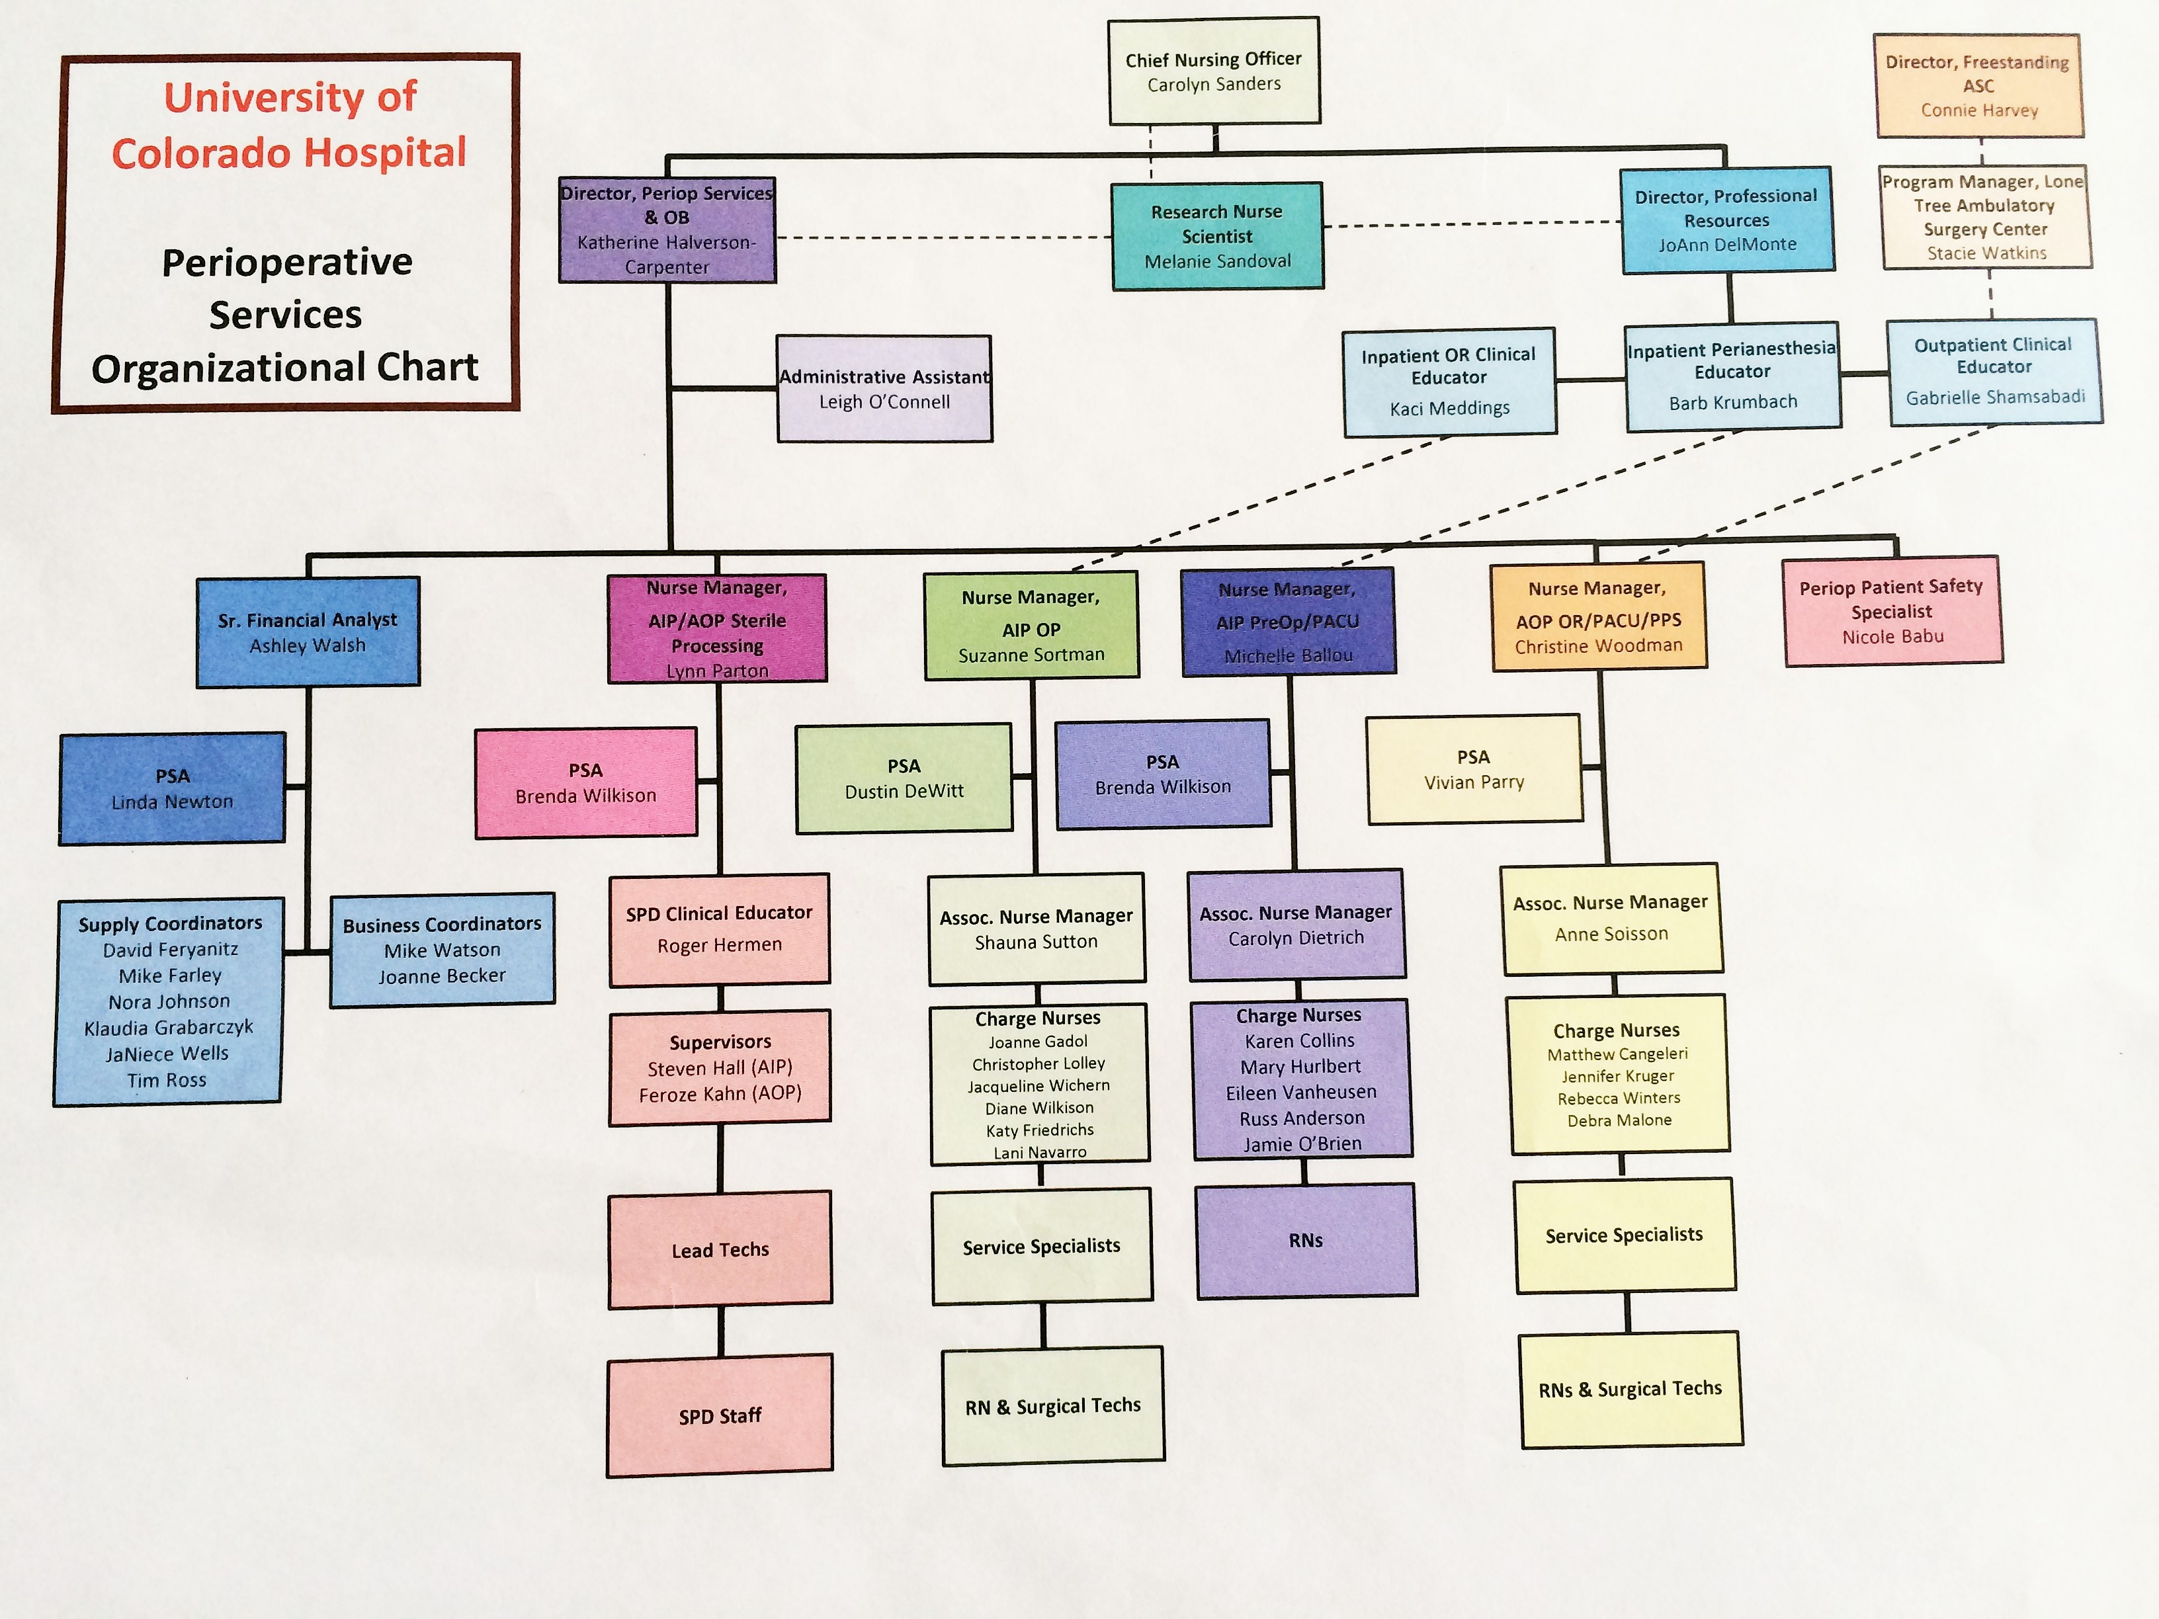
Perioperative leadership chart
* Please refer to the References tab of your manual at this time

Slide 18
Additional Resources
Forms and Documents
Preceptor Policy
  Responsibilities
  Accountability
Preceptor Pathway
- Mosby’s Preceptor Plan
- Websites
Available on the HUB at: http://hub.uch.edu/departments-services/preceptor-program/
AIP OR specific: http://uchor.weebly.com password: UCH3000

Slide 19

Preceptor Recognition
Preceptor recognition is essential to facilitate positive educational experience and supports staff satisfaction
Recognition can be provided by several different means:
- Management recognition
- Continuing education
- Leadership role
- Increased job satisfaction
- Financial incentive
              4%-6% differential (unit based rate) is provided to UCH staff who precept
              Differential is applied upon completing both online and classroom components
              Preceptor certificate is generated after online course evaluation is completed

Slide 20
Or specific facilitated discussion questions
Case Scenario #1
Focus:
- Evaluates preceptee current knowledge/skill level
- Differentiates between effective and ineffective communication techniques
- Evaluates preceptee’s clinical performance
Scenario: Emergency situation/big case
Preceptee: Connor, 23 year old male
Background: New Surgical Tech graduate (<6 months from completion of program certification), new hire to unit
Learning Style: Visual

Slide 21
Case Scenario #1 Questions
What concerns, if any, do you have related to Connor’s expectations in the scrub role? How would you communicate these concerns to Connor?
Considering effective communication techniques, how can you clarify what is expected of Connor?
What teaching methods would you use with Connor to develop his critical thinking related to the additional procedures?
How would you evaluate Connor’s clinical performance to know if he has met the procedure competencies?

Slide 22
Or Specific
Facilitated Discussion Questions
Case Scenario #2
Focus:
- Evaluates preceptee current knowledge/skill level
- Integrate preceptee as a professional member of the unit and/or health care team
- Recognize the phase of novice-to-expert theory and support preceptee through phases of progression
- Creates a supportive learning environment
- Utilize evaluation tools appropriately to document preceptee’s performance
Scenario: Experienced nurse/over confident
Preceptee: Ava, 28 year old female Registered Nurse
Background: 2 years clinical experience in the Operating Room, prior degree in Biology, new hire to unit
Learning Style: Kinesthetic

Slide 23
Case Scenario #2 Questions
What other information would you want to know about Ava and her experience?
From the information provided, what phase of reality shock might Ava be experiencing?
How would you create a supportive environment to assist Ava through this transition to the CT service?
Using the preceptee evaluation tool, what would you document as Ava’s areas of strength and areas for improvement?
What teaching strategies might you use to address Ava’s progress and her frustration with EPIC charting?

Slide 24
Or Specific
Facilitated Discussion Questions
Case Scenario #3
Focus:
Distinguish between the roles of protector, educator, and facilitator
Differentiate between effective and ineffective communication techniques
Identify teaching strategies compatible with the preceptee learning style
Utilize evaluation tools appropriately to document preceptee’s performance
Scenario: Orientee Emotional/Upset
Preceptee: Jack, 40 year old male new employee
Background: new Registered Nurse graduate, 12 years’ experience as a CNA in a nursing home, new hire to unit
Learning Style: Read/Write

Slide 25
Case Scenario #3 Questions
Can you identify any barriers that might affect Jack’s learning progress?
In considering the three roles of a preceptor, which role do you anticipate spending the most time in with Jack?
In considering Jack’s learning style, what strategies would you use to assist him in preparation for high case load shift?
What concerns do you have related to Jack’s progress in orientation?
Using effective communication, how would you respond to Jack’s emotional outburst when he exclaimed “scheduling four cases in a day is too much”?
Who else, if anyone, would you involve to address identified issues?

Slide 26
Or Specific
Facilitated Discussion Questions
Case Scenario #4
Focus:
Distinguish between the roles of protector, educator, and facilitator
Identify appropriate use of evaluation tools to appraise and document performance
Differentiate between effective and ineffective communication techniques.
Identify teaching strategies to promote critical thinking
Scenario: Incorrect Count
Preceptee: Nikki, 33 year old female
Background: Surgical Tech with 18 months clinical experience, previous EMT experience (3 years) new hire to unit
Learning Style: Auditory

Slide 27
Case Scenario #4 Questions
What concerns, if any do you have related to Nikki’s perceptions with the preceptee-preceptor relationship?
How can you identify Nikki’s remaining learning needs?
Besides direct observation, what other methods would you utilize to evaluate Nikki’s performance and competence?
What teaching strategies might you use to support and encourage Nikki’s overhead table organization?
Considering effective communication techniques, how can you help Nikki communicate incorrect count significance to the rest of the surgical team?

Slide 28
Conclusion
The use of preceptors as experienced staff to facilitate the orientation and retention of new staff is present throughout healthcare systems nationwide
The perioperative setting utilizes the unit specific leading organization, AORN, recommended practices to select and educate preceptors
The preceptor fulfills 3 primary roles to support the orientee/student by acting as the educator, protector and facilitator
The preceptor continues advancement in the role through the skill acquisition hierarchy, Benner’s Novice to Expert Theory
The preceptor continuously utilizes methods for constructive evaluation and effective communication skills

Slide 29
Conclusion
Addressing the preceptor role as a formal position with a clearly defined role description and organized professional practice guidelines can facilitate positive patient outcomes and encourages staff satisfaction in the perioperative setting
Accessibility to appropriate resources can support both personal practice and the guidance of others by use of evidence-based practice recommendations and teaching tools that support individual learning needs
The preceptee-preceptor relationship is vital to building a successful team and is supported in the AIP OR through the certification achieved post-course review

Slide 30
References
Altmann, T.K. (2006). Preceptor Selection, Orientation, and Evaluation in Baccalaureate Nursing Education. International Journal of Nursing Education Scholarship, 3, 1-15.
Duteau, J. (2012). Making a Difference: The Value of Preceptorship Programs in Nursing Education. The Journal of Continuing Education in Nursing, 43, 37-43.
Finger, S.D., & Pape, T.M. (2002). Invitational Theory and Perioperative Nursing Preceptorships. AORN Journal 76, 630-641.
Omansky, G.L. (2010). Staff nurses’ experiences as preceptors and mentors: an integrative review. Journal of Nursing Management, 18, 697-703
Speers, A.T. (2002). OPERATING ROOM REGISTERED NURSES INTERNSHIP PROGRAM: A Recruitment and Retention Strategy. Journal for Nurses In Staff Development, 18, 117-126
Zilembo, M., & Monterosso, L. (2008). Towards a conceptual framework for preceptorship in the clinical education of undergraduate nursing students. Contemporary Nurse, 30, 89-94

Slide 31
References
Benner, P. (1984). From novice to expert: Excellence and power in clinical nursing practice. Menlo Park: Addison-Westley, pp. 13-34
Mangram, A.J., Horan, T.C., Pearson, M.L., & Silver, L.C. (1999). Hospital Infection Control Practices Advisory Committee. Guidelines for prevention of surgical site infection, 27(2):97-132.
Simmons, E.P. (1982). Guideline for prevention of surgical wound infections. Infect Control. 3:185-196.
Van Wicklin, S. (2012). CDC surgical wound classification system/Surgical wound classification decision tree [Clinical Issues]. AORN Journal
Recommended practices for prevention of transmissible infections in the perioperative practice setting. In: Perioperative Standards and Recommended Practices. Denver, CO: AORN, Inc; 2013;331-364

Slide 32
References
AORN Recommended Practices and Preceptor Resources can be obtained through the following PDF file links:
http://www.aorn.org/Secondary.aspx?id=20973&terms=wound%20classification
http://www.aorn.org/Education/Curriculum/Periop101/Perioperative_Orientation_Resources.aspx

