Slide 1
AIP OR Preceptorship Survey Results
Presented by: Megan Hellrung
January 26,2014

Slide 2
OBJECTIVES
Recognize the current practice of preceptorship in the AIP OR and identify the role characteristics and barriers of practice through FOCUS PDCA format
Review October 2014 AIP OR Preceptorship Survey results
Compare/contrast survey results, FOCUS PDCA and current literature of preceptorship practice

Slide 3
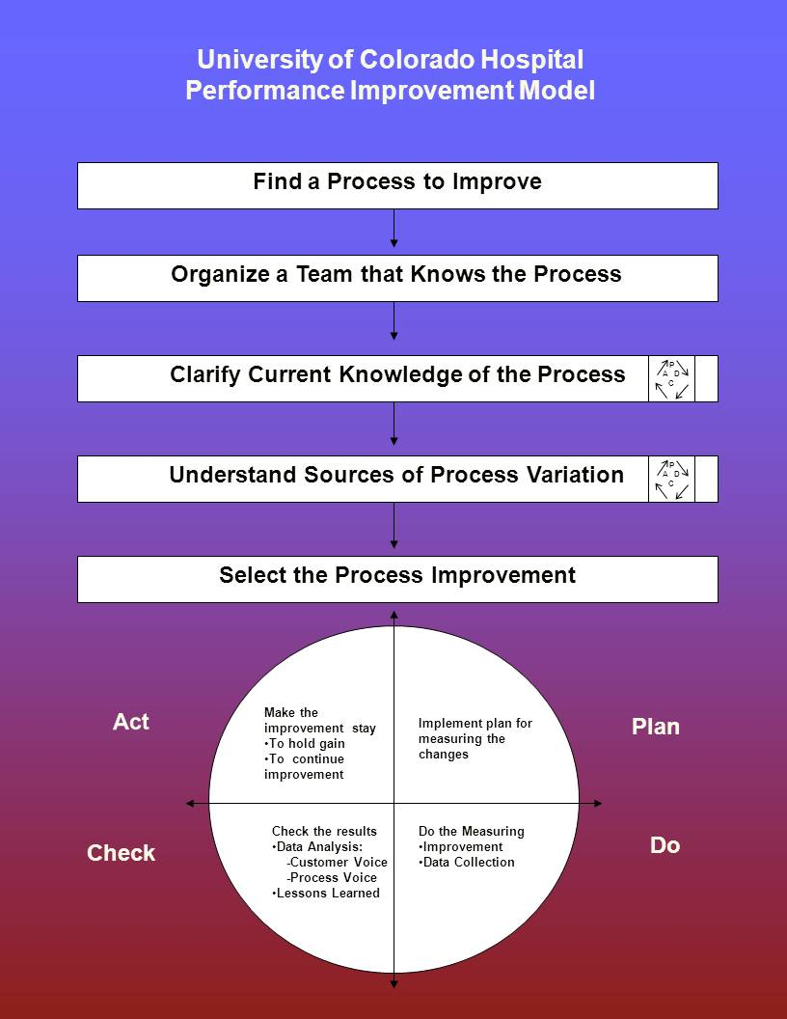
FOCUS PDCA
FOCUS PDCA is a performance improvement tool that is utilized in the UCH system as a process to identify a problem and create an organized plan of action

Slide 4
Find a process to improve
Opportunity Statement:
Preceptor role, responsibilities, education and expectations are undefined and under supported in conjunction with high turnover rate and quantity of novice staff
Tools/Sources:
Staff discussion, physician feedback, staff turnover, Preceptorship Survey results
Dimensions of Performance:
Efficiency, Staff Satisfaction, Safety, Continuity
- “A lack of definition of the preceptor role leading to role ambiguity was a theme with a large gap between the envisioned role of the preceptor and the reality of the role.” (Omansky, 2010)

Slide 5

Organize a team
Preceptor Council Chair/Perioperative Clinical Scholar (Lynette Zavodny), OR Educator (Kaci Meddings), PACU Educator (Monica Brock), AIP OR Charge Nurse (Joanne Gadol), Preceptor Program Coordinator (Bebe Hoff), OR Preceptorship Council Member/Evidence Based Practice Champion (Megan Hellrung)
AIP OR Staff

Slide 6
Clarify the current state
Preceptorship in the OR is a high demand role that lacks definition and organization, is not abundantly supported and does not hold any certification.
Feedback has been provided from staff discussion and attending surgeons about incomplete education of OR staff
Methods to confirm this state include:
1.) primary pre-intervention survey created to assess OR staff opinions and satisfaction with preceptorship
2.) A literature review of current nursing-based preceptor education/preceptorship programs with OR focus

Slide 7
Understand the root causes
The AIP Operating Room is a specialized care setting that requires specific and extensive training
In midst of an expansion, additional stress has been placed on orientation time and orientation resources
Experienced OR staff are expected to complete the increased case load and are also expected to properly educate and support the significant influx of new staff
The increased ratio of novice to experienced staff reality results in insufficient staffing and in turn affects staff experiences/satisfaction
Barriers to preceptorship: lack of recognition, informal or no preceptor training, increased workload, new specialty service development, arrival of new surgeons and preceptor fatigue

Slide 8

Select the improvement
SMART Aim Statement:
To clarify and standardize the role of the preceptor from vague principles and inconsistent practices to a formal position with a clearly defined role description, organized professional practice guidelines and clinical experience qualifications through the implementation of a OR Specific Preceptor Course and curriculum by March of 2015 in the AIP Operating Room.
“ Preceptorship can be useful, but only if well-designed criteria are employed to guide preceptor selection, education, orientation and evaluation.” (Altmann, 2006)

Slide 9
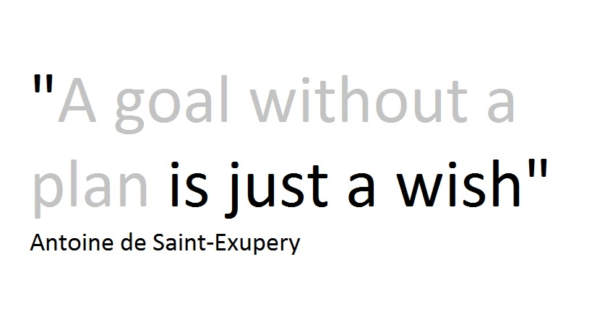
Plan the improvement
Primary intervention includes an OR Specific Preceptorship course with clearly outlined curriculum that both supports and challenges the preceptor in the clinical setting
Goal is to ultimately standardize the process of preceptorship through use of OR specific resources (I.E. AORN) with the purpose to assist in the education and training of novice staff to the OR

Slide 10
DO the improvement
This presentation in conjunction with the literature review and results of the AIP OR Preceptorship Survey are the primary tools utilized to facilitate the improvement intervention
Creation of an OR Specific Preceptor Course is the intervention formed from the literature review and results of the survey
-invites will be distributed to staff in groups of 6-12 learners per course in February of 2015 with the first course offered in March of 2015.
- “Limit the number of learners to a maximum of 12 and a minimum of six in order to ensure equal distribution of clinical learning experiences.” (Speers, 2002)

Slide 11
Check the Results
Follow-up and continuing evaluation is essential to monitor effectiveness and satisfaction with the newly developed curriculum and training
Immediate post course (OR Specific Preceptorship Course) survey will be administered and must be completed in order to receive certification
Follow-up surveys (Survey Monkey) will be distributed for both the staff that has completed the training and also for those who have been precepted by the newly trained staff
Individual interviews will also be done (at random) to assess satisfaction with course and curriculum

Slide 12
Act and determine next steps
Continue second and third rounds of the OR Specific Preceptorship course to upkeep and support this role change
Continue to obtain evaluation through surveys and interviews
Make necessary revisions to course provided by survey results and interview recommendations
- “The effective preceptor continually evaluates the orientation program and if necessary alters it to meet the needs of the learner” (Finger & Pape, 2002)

Slide 13
Survey results
10 question survey on preceptorship practice in the AIP OR that was distributed to all AIP OR Staff on 10/1/14 and closed 10/31/14
The survey included multiple choice, ranking and free text comment type questions
The survey had a total of 69 responses

Slide 14

1. In your own words, how would you define the role of preceptorship in the operating room?
The most trending response was (to) educate/teach
“ teaches, counsels, inspires, serves as a role model, and supports the growth and development of a student for a fixed and limited amount of time.” (Duteau, 2012)

Slide 15

2. In your own words, what are some characteristics of a preceptor in the operating room?
The most trending responses were patient & knowledgeable
“Clinical competence, commitment to the preceptor role, willingness to teach, effective communication skills, professional conduct, skill, ability to deal with conflict, ability to complete evaluations and knowledge were central factors in the selection of clinical preceptors.” (Duteau, 2012)

Slide 16
3. How many shifts per week do you work as a preceptor?
“Some nurse preceptors found that they lacked control over whether they would be a preceptor, and that they were being assigned to this duty with no input.” (Omansky, 2010)

Slide 17
4. Preceptorship in the AIP OR is a formal and clearly defined role with organized professional practice guidelines, achievable goals and supports clinical efficiency on the unit.
“Research recommends preceptor training as a mandatory competency to reflect the importance of the preceptor role.” (Zilembo & Monterosso, 2008)

Slide 18
5. The AIP OR would benefit from the development of a preceptor program curriculum that includes a clear set of criteria and goals for precepting alongside a defined ROLE description and clinical experience qualifications.
“Preceptorship planning was one essential component in the retention of perioperative nurses.” (Duteau, 2012)

Slide 19
6. Please rank the rewards associated with preceptorship in the OR, according to importance.
(1 is the most important reward related to precepting and 5 is the least important reward related to precepting)
“Preceptors benefit from participating in the preceptorship experience in terms of intrinsic rewards such as teaching opportunities and enhancing one’s knowledge base” (Zilembo & Monterosso, 2008)

Slide 20
7. Have you attended the University of Colorado Hospital’s Basic Preceptor Course?
Yes, I have attended this course and achieved the post-course certification (39.1%) (27)
No, I have not attended this course (60.9%) (42)
“A well-planned preceptorship program could improve recruitment and staff member satisfaction and reduce staff turnover. Using preceptors also maximizes hospital resources.” (Finger & Pape, 2002)

Slide 21

8. If you answered yes to the previous question, what was the most helpful and what was the least helpful about the UCH Basic preceptor Course?
The most trending response was “I don’t really remember”

Slide 22
9. Please select your primary role as an AIP or staff member:
Clinical Nurse (61.2%) (45)
Surgical Technologist (25.0%) (17)
Clinical Nurse Educator (1.5%) (1)
Service Specialist (5.9%) (4)
Management (1.5%) (1)

Slide 23
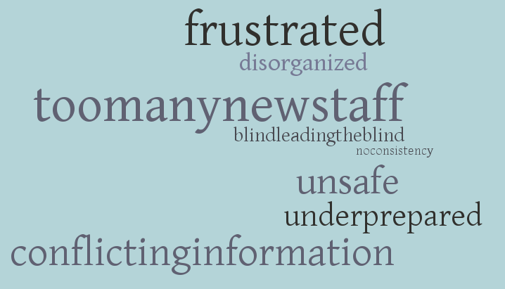
10. Please share any additional comments and/or concerns with preceptorship in the aip or:

Slide 24
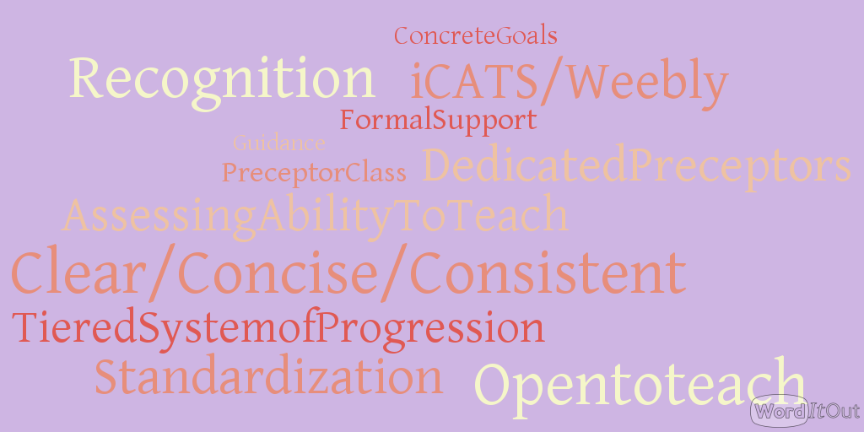
10. Please share any additional comments and/or concerns with preceptorship in the aip or CONT.

Slide 25
Conclusion
The use of clinical preceptors are well documented and researched through the comprehensive literature review
Clinical preceptors are utilized on national scale and are a cost-effective method of providing appropriate theoretical knowledge and clinical experience training
A lack of definition of the preceptor role leads to role ambiguity, role conflict and role overload
Development of a well-planned preceptorship program has a positive effect on the developmental growth of staff, improves recruitment, increases staff satisfaction and reduces staff turnover

Slide 26
Conclusion cont.
A high level of performance is demanded of AIP OR staff in order to prevent negative or adverse patient outcomes
AIP OR staff are expected to maintain both clinical and technical expertise during times of rapid change and growth to our unit
The AIP OR has recognized a need for a clear set of criteria to support the preceptor role expectations, qualifications and characteristics through survey data
Development of an OR Specific Preceptorship Course will support standardization to the role of preceptorship by implementing specific curriculum to assist with education of the preceptor and in turn, education of new staff

Slide 27

Questions/Comments/Concerns

Slide 28
References
Altmann, T.K. (2006). Preceptor Selection, Orientation, and Evaluation in Baccalaureate Nursing Education. International Journal of Nursing Education Scholarship, 3, 1-15.
Duteau, J. (2012). Making a Difference: The Value of Preceptorship Programs in Nursing Education. The Journal of Continuing Education in Nursing, 43, 37-43.
Finger, S.D., & Pape, T.M. (2002). Invitational Theory and Perioperative Nursing Preceptorships. AORN Journal 76, 630- 641.
Omansky, G.L. (2010). Staff nurses’ experiences as preceptors and mentors: an integrative review. Journal of Nursing Management, 18, 697-703
Speers, A.T. (2002). OPERATING ROOM REGISTERED NURSES INTERNSHIP PROGRAM: A Recruitment and Retention Strategy. Journal for Nurses In Staff Development, 18, 117-126
Zilembo, M., & Monterosso, L. (2008). Towards a conceptual framework for preceptorship in the clinical education of undergraduate nursing students. Contemporary Nurse, 30, 89-94

